Slide 1
Lab 1 - HTML and CSS

Slide 2
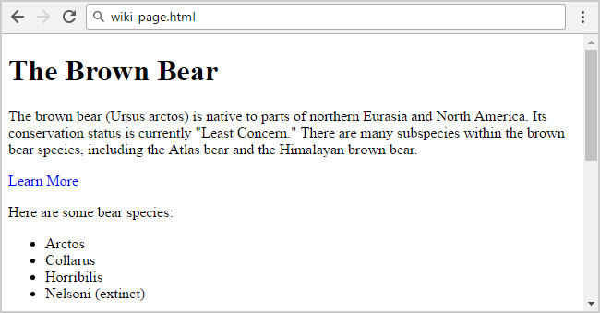
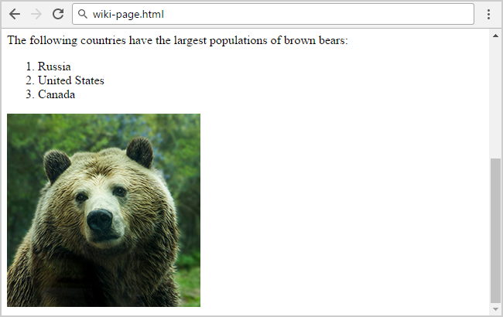
Lab 1 – HTML and CSS
Wiki Page
Create a Web Page named "wiki-page.html" like the following:
Constraints
• Title: The Bear
<h1> for heading
• Hyperlink: https://en.wikipedia.org/wiki/Brown_bear
• Text: use paragraph <p> </p>
• List: use ordered list and unordered list
• Image: bear.jpg (any image of a bear you can download)
Notes:
The brown bear (Ursus arctos) is a large bear species found across Eurasia and North America.^{[1][3]} In North America, the populations of brown bears are called grizzly bears, while the subspecies that inhabits the Kodiak Islands of Alaska is known as the Kodiak bear.
<a href="Brown bear - Wikipedia">Learn more</a>!

Slide 3
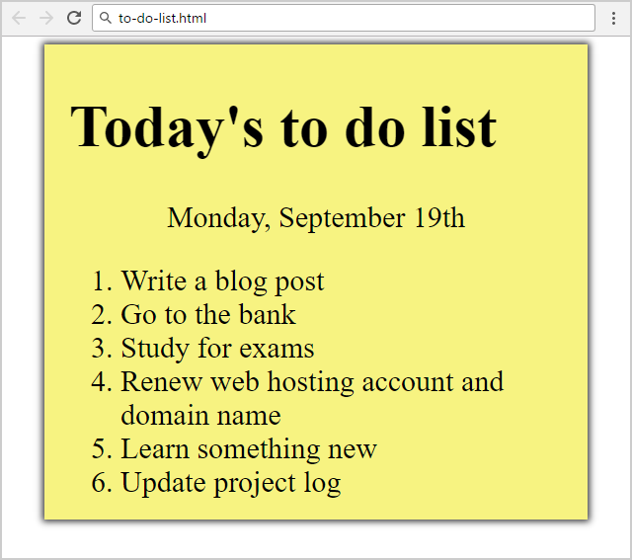
Lab 1 – HTML and CSS
2.To Do List
Create a Web Page named ”to-do-list.html" like the following:
Constraints
<div> with class="my-list" as container
Background color: #f7f381;
Padding: 8px 24px;
Width: 500px;
Text size: 30px;
Border: 1px solid #f7f381;
Background Color: #f7f381;
box-shadow: 0 0 10px 2px #333333;
<ol>
Margin: 12px;
<p>
Center the text
Hints
Center the container
Heading: use <h1>
Date: use <p> + center it
List: use <ol>
Create two files: "to-do-list.html" and "to-do-list.css"

